Slide 1
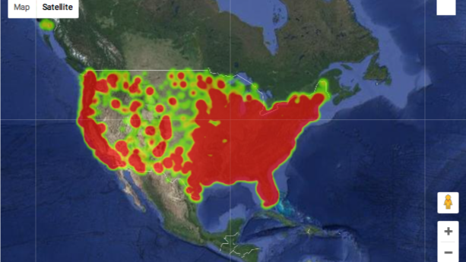
American Gun Violence in 2017
Amgad Farah, Muhammad Faisal Shabbir, Alicia Saracina
GW Data Analytics

Slide 2
Motivation & Summary
Core message/hypothesis:
Gun violence will vary by region and there is no correlation with time of the year
Questions:
In which state is gun violence the highest?
In which city is gun violence the highest?
Does gun violence rise during different times of the year?
How many guns are used per incident?
Purpose:
Recent school shootings prompted us to better understand gun violence in the US.
Findings:
Chicago, Illinois has highest rates
Washington is second highest city
Enter MONTH result here
Majority of incidents involve one gun only
Notes:
Motivation & Summary Slide
Define the core message or hypothesis of your project.
Describe the questions you asked, and why you asked them
Describe whether you were able to answer these questions to your satisfaction, and briefly summarize your findings

Slide 3
Questions & Data
Questions:
In which states and cities is gun violence the highest?
Does gun violence rise during different times of the year?
How many guns are involved per incident?
Sources:
https://www.kaggle.com/jameslko/gun-violence-data
The data set is downloaded from gunviolencearchive.org, a non-profit dedicated to providing public data on gun violence.
Gun violence is measured by number of incidents involving guns (including non-fatal incidents)
Notes:
Elaborate on the questions you asked, describing what kinds of data you needed to answer them, and where you found it

Slide 4
Data cleanup & exploration
Exported raw data from our source and converted to csv file
In Jupyter, initial clean up included removing columns we wouldn’t be using
Import pandas, matplotlib, datetime
Used pandas to create a new data frame with only the fields we wanted
Reviewed overall totals and summary statistics like max, min, total
Used matplotlib to create graphs on the questions we wanted to explore further
Re-edited graphs after initial review of graphs for better presentation

Slide 5
Data analysis
Where is gun violence occurring?

Slide 6
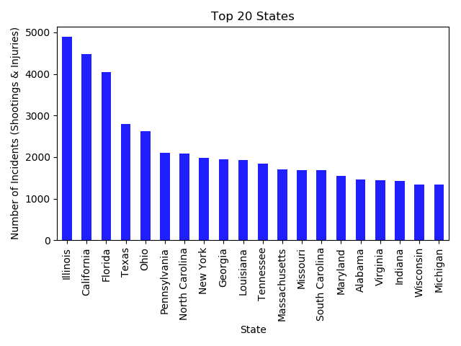
Data analysis
In which state is gun violence the highest?

Slide 7
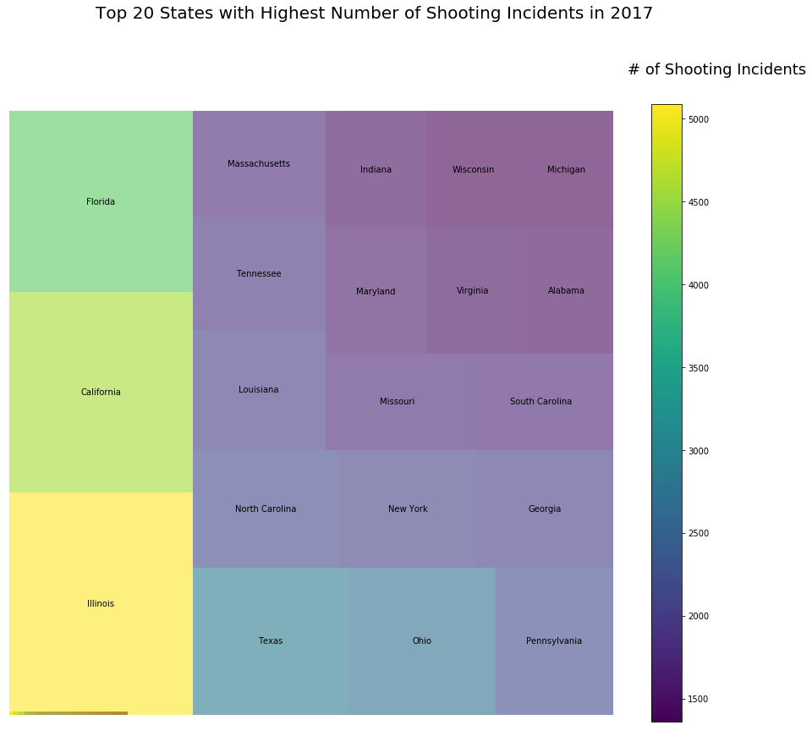
Data analysis
In which state is gun violence the highest?

Slide 8
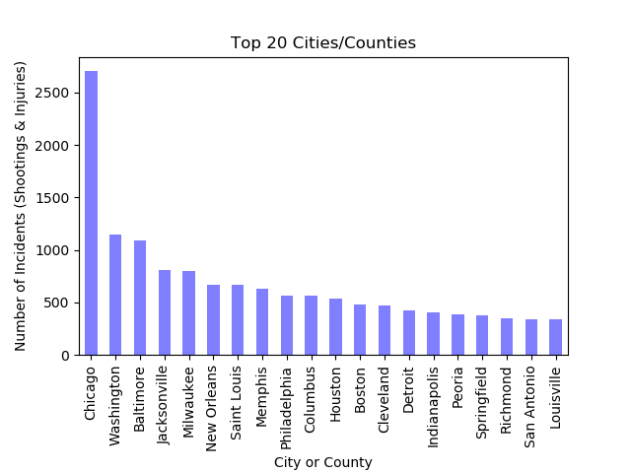
Data analysis
In which CITY is gun violence the highest?

Slide 9
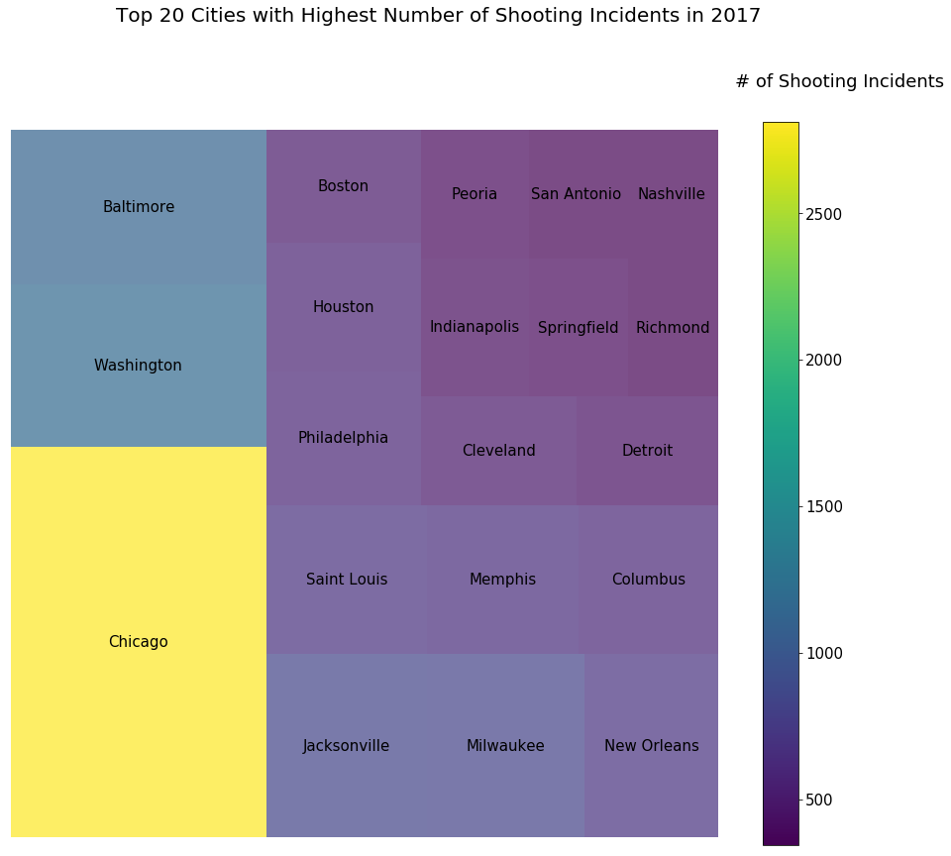
Data analysis
In which city is gun violence the highest?

Slide 10
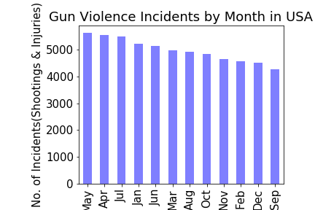
Data analysis
At what time of year is gun violence the highest?

Slide 11
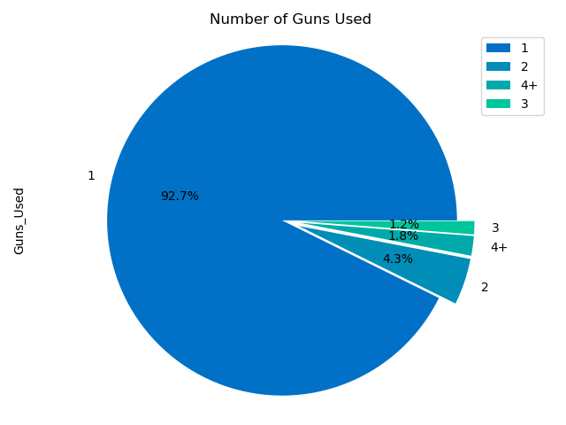
Data analysis
How many guns were used?

Slide 12
discussion
Did not expect Illinois to be the top state and by such a large margin
Did not expect Washington to be second highest city
Surprised by the high number of guns used in some incidents (up to 49 in one instance)
Surprised by the month of May being the highest month (graduation season)
Notes:
Discuss your findings. Did you find what you expected to find? If not, why not? What inferences or general conclusions can you draw from your analysis?

Slide 13
Post mortem
Difficulties
Size and scope of data
Additional Questions
Population analysis
Multi-year analysis
Legal status of gun used
Graphs were difficult to construct
Age analysis
Gender
Gun law comparison
Notes:
Discuss any difficulties that arose, and how you dealt with them
Discuss any additional questions that came up, but which you didn't have time to answer:
What would you research next, if you had two more weeks?

Slide 14

questions

